Slide 1



Slide 2
SEVENOAKS DISTRICT COUNCIL
LOCAL PLAN, REGULATION 19
This isn’t simply another opportunity to say whether we like or dislike a development. It is an opportunity to ask whether the Local Plan meets the tests of soundness.
We need to ask whether the housing numbers and assumptions are robust whether reasonable alternatives have genuinely been considered, whether the ‘exception case’ for releasing Green Belt has been demonstrated, and whether the infrastructure, transport, water, drainage, healthcare, affordable housing, and other requirements, are actually deliverable.
The question isn’t simply “Can Broke Hill and other sites be allocated?”
The question is whether the evidence demonstrates that it should be.
That is what Regulation 19 and the independent examination are there to test.

Slide 3
We need to do all we can to prevent this Local Plan from being passed. The primary reason for this is that it is only national political change that is likely to repeal the Grey Belt legislation.
If we have an adopted local plan that has been put in place “with proper consultation” it is highly unlikely that any future government would remove the plan. However, new plans with Green Belt building would not be passed. This plan, as it stands, will have a disproportionate and significant urban impact on the rural north of the District.
THIS IS WHY REGULATION 19 REPRESENTATION MATTERS

Slide 4
Sites in the Local Plan that impact Halstead
ST2-34 Land south of Parkside and Southdene Halstead 0.35 Ha 16 units
ST3-7 Highfield farm and Knockavilla, Crow drive Halstead 0.86 Ha 32 units
ST3-8 Helipad Site Crow Drive, Fort Halstead, Halstead 0.86 Ha 32 units
ST3-9 Land west of Beaumont Yard, Crow Drive, Halstead. 0.78Ha 29 units
ST5-1 Broke Hill Golf Course, Halstead size 65.67 Ha 810 units
Fort Halstead should also be included 635 units (this is part of extant permissions - sites with PP at 31st March under construction) p. 48
The plan states that Halstead has 151 units (included some of those above and planning that has already been passed)
ST2 Urban sites • ST3 Previously Developed Land • ST5 Green field Site
Grand total 1,596

Slide 5
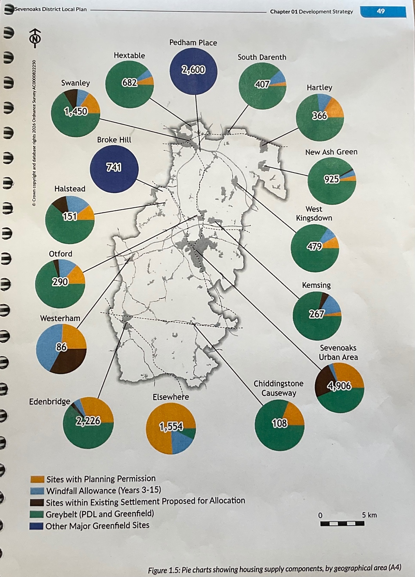
Allocation across district

Slide 6
Evidence and Reasoning
Plan-making Policy OB
Does the development proposed meet national policy? Has there been cross-boundary co-operation?
The Plan is not effective. It has not demonstrated co-operation between plan-making authorities (i.e. London Borough of Bromley (LBB), Transport for London (TfL), National Highways, and Kent County Council (KCC)). Inclusion of site ST5-1 (Broke Hill) in the plan is contrary to NPPF 2024 Chapter 2 Maintaining effective co-operation paragraph 24, 25, 26 (infrastructure) and 27a.
Once the matters which require collaboration have been identified, strategic policy- making authorities should make sure that their plan policies align as fully as possible with those of other bodies where a strategic relationship exists on these matters, and take into account the relevant investment plans of infrastructure providers, unless there is a clear justification to the contrary. In particular their plans should ensure that:
a consistent approach is taken to planning the delivery of major infrastructure, such as major transport services/projects, utilities, waste, minerals, environmental improvement and resilience; and strategic health, education and other social infrastructure (such as hospitals, neighbourhood health facilities, universities, schools, major sports facilities and criminal justice accommodation);
c) any allocation or designation which cuts across the boundary of plan areas, or has significant implications for neighbouring areas, is appropriately managed by all relevant authorities.
The plan has not demonstrated with sufficient evidence or in the infrastructure Project Schedule that it has planned for the impact of 810 housing units on health, traffic, water supply and education.

Slide 7
Development Strategy - Policy DS
The plan has not been positively prepared. Reasonable alternatives have not been considered.
DS01 4.14 states that before green belt land is released the council should have looked at brownfield sites and assessed these. This is in accordance with NPPF Chapter 12 para 126.
DS01 4.20 (p44) The Council states that there is only 7% of the district is identified as ‘built up’ and therefore the plan proposes limited Green Belt release. What evidence is this based on - where is the brownfield assessment?
DS01 4.9 (p38) The plan states that the DS will create healthy, well supported communities - not simply deliver new homes. These places must be accompanied by services, facilities and infrastructure. The plan fails to deliver this in regards to ST5-1 or Fort Halstead - this is just a case of delivering new homes without the infrastructure (see SDC Infrastructure project schedule). Adequate provision has not been made for health, water, wastewater & drainage, public transport, roads and secondary education. There is inadequate provision to create healthy, well-supported communities.

Slide 8
The inclusion of new developments in Halstead Village is contrary to SDC’s own policy as part of the development strategy:
DS01 4.8 (p.38) New development must respect varied and distinctive places and communities and respond positively to local character. The new development of ST5-01 is contrary to this policy, doubling the size of the village of Halstead and not reflective of the local housing density of 13-18ph not 45-60ph.
Halstead Village is not a Principal Town, or a Primary service or Secondary Service Settlement. It is a village.
DS01 4.11(p.38) SDC states it has worked closely with Parish Councils to create this plan - this has not happened.
DS01 4.28 SDC has updated its Settlement Hierarchy in order to fit ‘exceptional circumstances’ by calling Pratts Bottom a secondary service settlement.

Slide 9
A Balanced Strategy for Growth - Policy ST1
The scale of development in the plan for Halstead is not proportional to the district hierarchy.
  The plan does not promote balanced growth in Halstead. Policy states ST1 “villages will see only small-scale development, limited, or infill development to support rural communities. The inclusion of sites (ST2-34, ST3-7, ST3-8, ST3-9, ST1-1 and Fort Halstead (previously passed and part of extant permissions) totals 1,596 units
  This does not support rural community of Halstead of 750 homes, and is contrary to SDC’s own policy.
  Halstead was identified in SDC’s Housing Needs survey as needing only 13 new affordable homes - this is being fulfilled by rural housing project in the village already. This also complies with SDC Plan Policy H3 Housing in Rural Areas. SDC has not applied the correct methodology when allocating large numbers of houses to Halstead in the plan.
  The density and scale of these combined developments would be contrary to policy ST1 - a balanced strategy for growth.

Slide 10
Green Belt Methodology: NPPF and Policy NE
The plan is not consistent with National policy. The council has not demonstrated Green Belt Methodology appropriately.
DS01 p.35 The Council states it needs to protect our green and natural spaces for current and future populations. Including site ST5-1 in plan is contrary to NPPF Chapter 13 paragraph 143 - the purposes of the green belt
    protecting against urban sprawl
    prevent neighbouring towns merging into one another
    safeguarding the countryside.
This site will cause significant harm to the Green Belt. SDC needs to ensure that substantial adverse weight is given to any harm to the Green Belt (NPPF Chapter 13 paragraph 153).
When defining Green Belt boundaries, even as a result of altering established Green Belts, local plans should include ‘washed-over’ villages (villages that sit entirely inside the Green Belt) to restrict development, because of the important contribution the open character of the washed-over village makes to the openness of the Green Belt (NPPF policy). The plan has not demonstrated correct use of Strategic Assessments to assess Green Belt.

Slide 11
Green Belt Methodology: NPPF and Policy NE
NPPF Chapter 13 paragraphs 145 & 147 states that Strategic Assessments should be carried out by councils to release land from Green Belt under ‘special circumstances’. Sevenoaks did an ARUP assessment in which ST5-1 scored highest on Purpose (a): protecting against urban sprawl. The council are not using their own assessments appropriately by including this site in the plan under ‘special circumstances’.
DS014.24 2 Sites that fall into other Green Belt locations (Broke Hill and Pedham Place): SDC state that they are ‘exceptional circumstances’ sites. This is in direct contradiction to its own assessments.
An important consideration regarding secondary settlements:
DS01 4.28 SDC has updated its Settlement Hierarchy in order to fit ‘exceptional circumstances’ by calling Pratts Bottom a Secondary Service Settlement.
Pratts Bottom has been identified in the plan as a Secondary Settlement so that ‘exceptional circumstances’ could be applied to site ST5-1. Villages should not be identified as settlements for the purpose of the spatial strategy in the development plans when defining Green Belt boundaries.

Slide 12
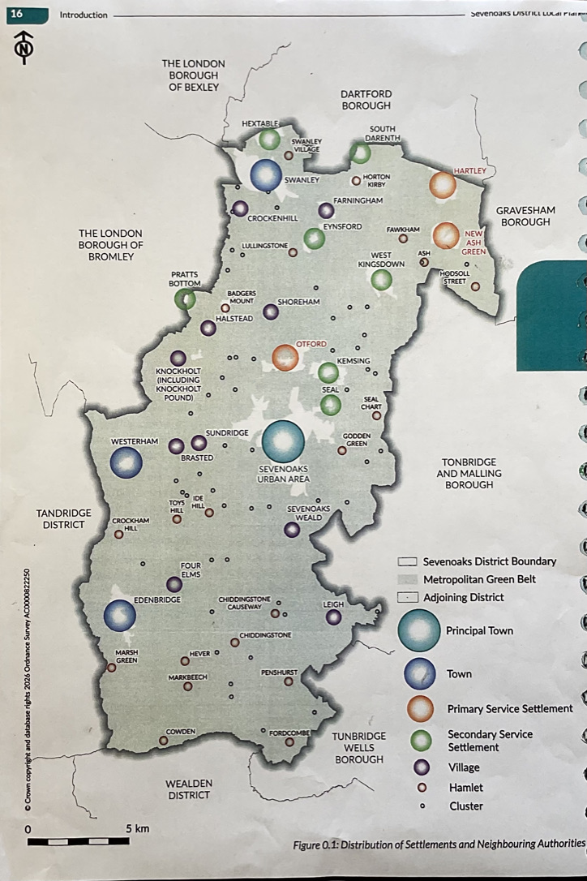
When SDC did an audit of locations in 2022, Pratts Bottom village (which is still regarded a rural village by Bromley Council) scored only 9 for essential infrastructure. A score of 9 indicates the settlement contains a bare minimum of low-order daily facilities, even though there used to be two general stores (plus the garage shop), a post office, and a hairdresser’s salon.
In SDC’s latest audit, the score has increased to 39. This elevated score is questionable given the loss of those low-order daily facilities, which have been replaced by a kitchen door shop, a haberdashery shop, etc. With this new score Pratts Bottom now becomes a Secondary Settlement.

Slide 13
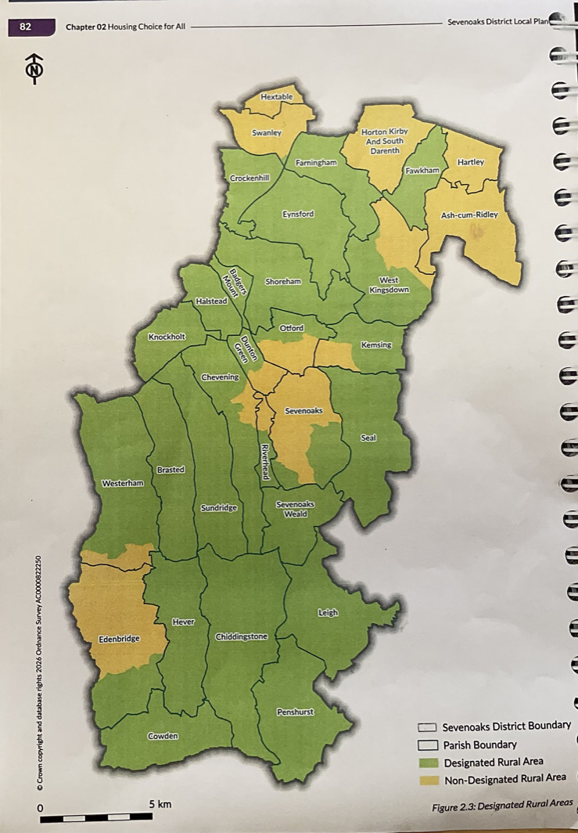
Housing - Policy H3 housing in rural areas
The scale of development proposed for Halstead:
ST2-34 Land south of Parkside and Southdene Halstead 0.35 Ha 16 units
ST3-7 Highfield farm and Knockavilla, Crow drive Halstead 0.86 Ha 32 units
ST3-8 Helipad Site Crow Drive, Fort Halstead, Halstead 0.86 Ha 32 units
ST3-9 Land west of Beaumont Yard, Crow Drive, Halstead. 0.78Ha 9 units
ST5-1 Broke Hill Golf Course, Halstead size 65.67 Ha 810 units
AND the units already allocated to Fort Halstead (635 units) is contrary to the plan policy.
Policy H2 Housing p.82 of the Local Plan:
Halstead is identified as a ‘designated rural area’. In designated rural areas (as defined under section 157 of the Housing Act (1985)) lower thresholds of affordable housing apply.
Again, the amount of houses planned is against SDC’s own policy.

Slide 14
Health and Wellbeing Policy HW
The plan does not promote the quality of existing residents’ mental health, or that of the many visitors to the area, such as Duke of Edinburgh trainees, ramblers, cyclists, etc. Visitors comes from the whole of London south of the River Thames.
    The plan states in OB1 “recognise link between places and spaces we live in and the quality of residents’ mental and physical health”.
The inclusion of ST5-1 would have negative impact on quality of village residents’ mental health.
The plan is in direct conflict of the statements below, because ST5-1 will impact on the Halstead villagers’ access to green open space. SDC quote in the plan that:
    “The quality of the built and natural environment can directly influence healthy behaviours and have positive impacts on reducing health inequalities”.
        HW6.1 provision is made to ensure all residents have opportunity to improve wellbeing
        HW6.2 Good quality housing in a sustainable location, with access to green open space, can positively benefit social networks and opportunities for active travel.
The Health Impact Assessment is the tool that SDC are using to assess adverse impact on health. Having read this we cannot see how this is implemented to assess adverse impact to residents who are currently living in areas that have been targeted for building.
    ST5-1 in the plan is contrary to policy HW3 1.a. “Ensure existing occupants of nearby properties will not be significantly impacted by obtrusive light, noise, vibration or other pollution”.
    Also policy AQ1 1.b impact on biodiversity.
The plan states in policy AQ3 That Schemes where unacceptable impacts cannot be overcome by mitigation should be refused. ST5-1 will have unacceptable impact on biodiversity, noises and unacceptable light pollution of a ‘dark village’ and therefore should be refused under SDC policy.

Slide 15
Climate Change CC
Climate Change Policy CC4 1.
“For every dwelling built, a minimum of 2 trees should be planted” … in favour of on-site planting.
Where is this evidenced in regard to ST5-1 and Fort Halstead?
How will SDC monitor this and implement it?
Historic Environment Policy HE
Halstead village has a conservation area and listed buildings - as identified on SDC figure 7.1 Designated Heritage Assets p. 214.
The inclusion of the sites in the plan for Halstead that total almost 1600 units will have a negative impact on the village. It is contrary to SDC policy OB20: “to protect and enhance districts historic environment for future generations”.

Slide 16
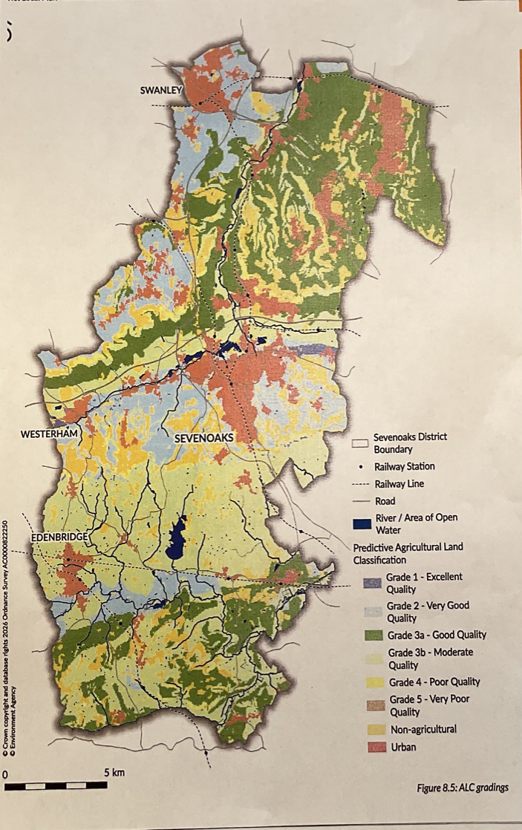
The Natural Environment NE
OB19 Ensures the district protects the natural beauty of the Kent Downs and biodiversity net gain is delivered on any new development. The assessment that was included in the application for ST5-1 identified biodiversity loss, not net gain. Inclusion of this site is in conflict with SDC policy.
The inclusion of ST5-1 will have a negative impact on the natural beauty of the landscape of the site. The ‘Public Rights Of Way’ Act (2000) states that public authorities should seek to further the purpose of enhancing the beauty of the area. Site ST5-1 is located in the North Downs has 66 hectares of open countryside with PROWs that would be not be enhanced by the building of 810 units. These homes would also impact on the dark skies. This is in direct conflict with SDC policy NE 8.10
  SDC is not following NPPF policy or its own BW3 8.47 See figure 8.5 p265 by including site ST5-1. Halstead parish is identified as ‘very good’ and ‘good quality’ agricultural land in the location of ST5-1. NPPF recognises the benefits of this land and states that plans should allocate land with least environmental or amenity value. When looking at the map of the district (p.285) Halstead is not a ‘poor quality’ area; in fact it is ‘very good’ according to SDC’s own gradings.

Slide 17
Infrastructure and Community Policy IN
  Can development realistically be supported and delivered?
  Has the plan properly assessed congestion, safety and sustainable transport?
  Is there sufficient capacity, or is development proposed ahead of essential infrastructure.
SDC state in IN 9.1 hat there will be significant investment in infrastructure and upgrading of existing infrastructure. This includes:
Transport - public, parking, walking and cycling.
Green and Blue Infrastructure - PROW, Green spaces, protected landscapes (ANOB)
Social infrastructure - Education, Health, Sports and leisure facilities, Emergency services, Libraries and community centres.
Utilities and hard infrastructure - electricity, gas, water, sewerage, waste and recycling, telecommunications and broadband.
This does not address many areas of infrastructure that the sites in the plan for Halstead, (totalling 1,596 units) will need.
The only other infrastructure planned is A21/Hewitts roundabout capacity improvements: “to improve capacity at junctions through widening works. This will be developer-funded”. TfL are waiting for the developer to agree payment for any essential road safety works, such as addressing speeding around the roundabout and the adjoining A21 by the use of speed cameras and traffic lights.
Knockholt station will have step-free access to platform 2, increased staffing hours, and improved access to station and carpark which, again, will be developer funded.

Slide 18
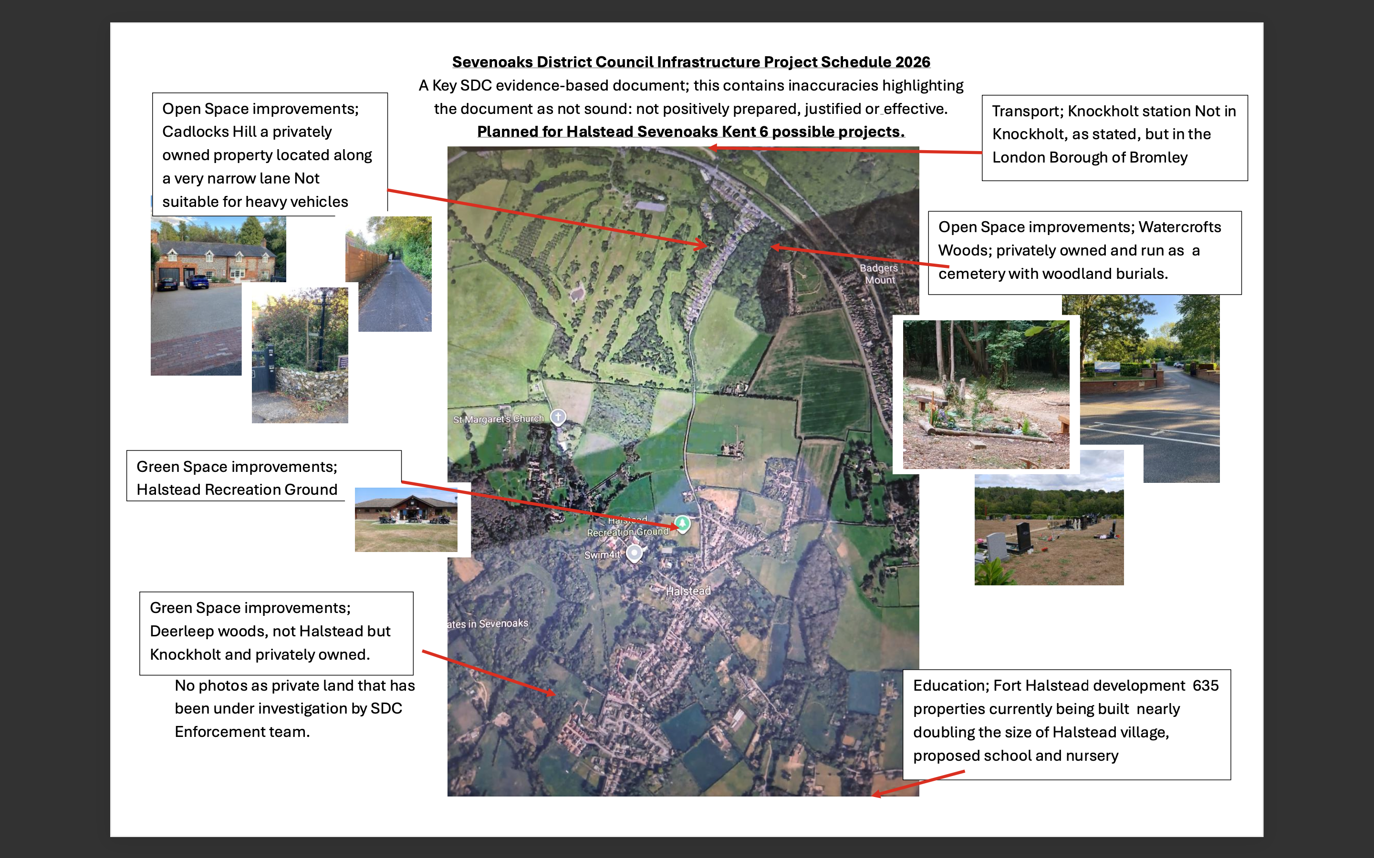

Slide 19
Transport T
T10.2 The plan focuses on the delivery of a sustainable movement network that supports healthy, inclusive and low-carbon patterns of movement, and provides realistic choice for how people travel in everyday lives. It aims to reduce the need to travel by private car and supports the creation of well-functioning places.
T10.11 in the Plan recognises that the district has higher-than-average car ownership, particularly in rural areas, indicating the reliance on private vehicles.
As evidenced in the Local Plan Site Assessment Report (August 2026) p.13, at 3.3 Stage 1 Results Summary, Halstead is identified as a ‘red cluster’, which means it is car-dependent and that there is a “low potential for modal shift”.

Slide 20
Has the Plan been Positively Prepared?
Additional inaccuracies in the Plan
DS 01 4.37 (p.55)
  ST1-5: ‘714’ homes. On previous page ‘741’. It should be 810.
  Also states it is a former golf course and driving range. That was 8 years ago - it is now re-wilded.
  Club house - this was burnt down in 2018.
  It states areas of hardstanding - but does not state the sizes of these, which is under 0.5 hectare.
  Not accurate description of high performing greenbelt.
Design DE3 5.18 “Each of the larger sites in the plan has a development brief where we set out our high-level vision and expectations for the site as well as bring together the other policy considerations into one document - this will be assessed at the Reserved Matters stage of the outline Planning Application”. This should be included now.

Slide 21
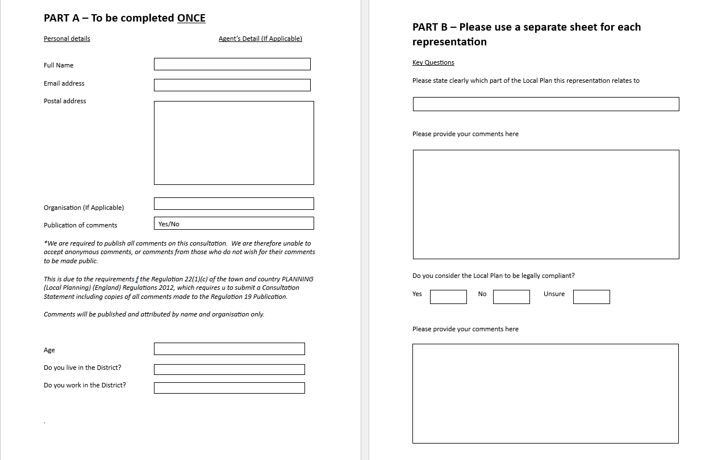
Filling in the Reg 19 Form
Paper copy form

Slide 22
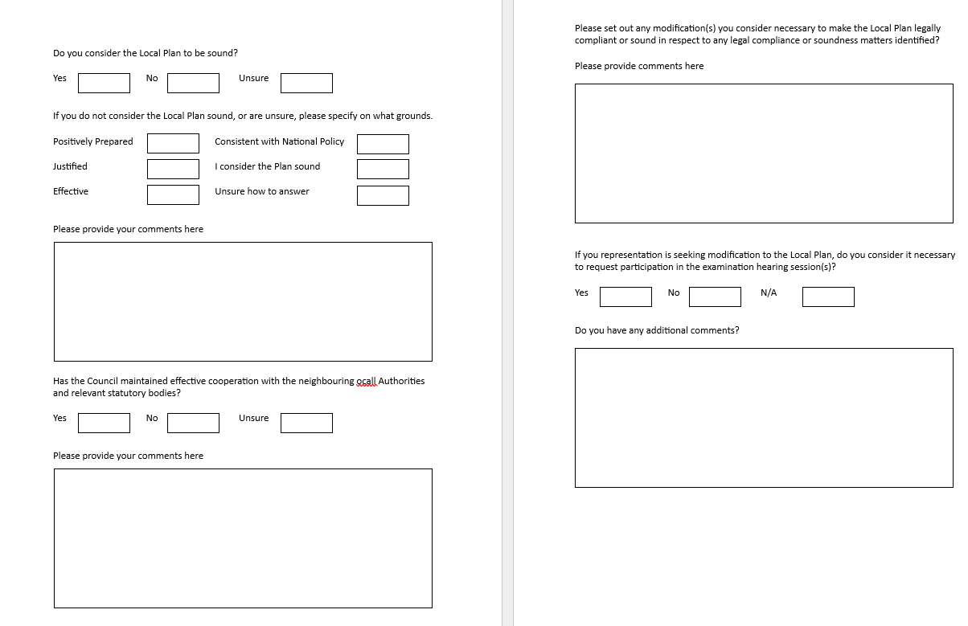

Slide 23
Completing the on-line form/ advice from Harry
This has been a bit trickier for some to navigate https://www.sevenoaks.gov.uk/info/20069128/emerging_local_plan/914/local_plan_regulation_19_publication
It is set out in a similar way to the paper copy on the have your say page. However, some respondents have completed all sections and some have not.
The boxes fill up quickly so you can attach a word document if needed.
Having met briefly with SDC Harry, we have been informed that you can email your comments in to planning and they will complete the online form for you.
You need to ask for an ID reference when you mail so that you can see your response on SDC website.
All forms will go to the Planning Inspector
SDC will use the forms to create analysis
Several members of public have already been into SDC to complain/discuss forms

