Slide 1



Supporting independent
living through Homeshare

Slide 2
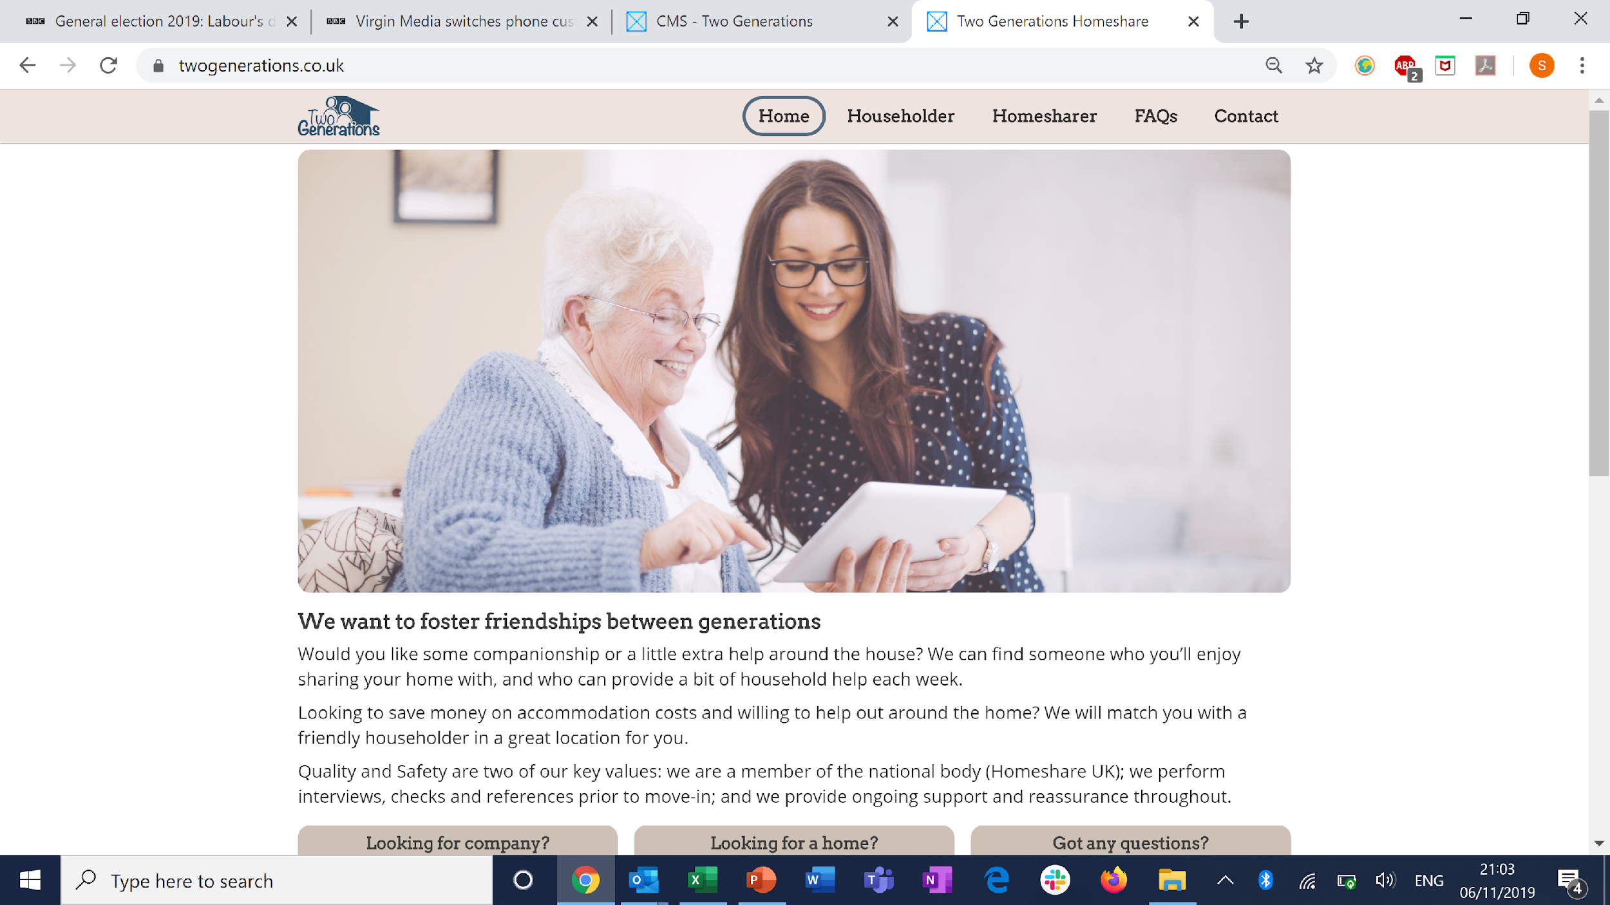
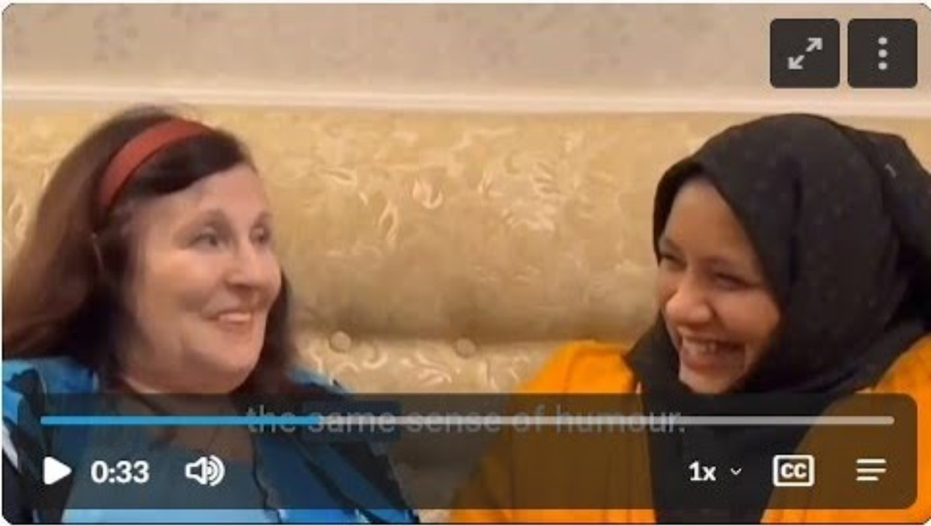
Hear From Homesharers

Slide 3
A Social Enterprise, since 2019
National Service
Nesta award-winning matching platform
70+ homeshares to date, “Perth to Plymouth”
Public and 3rd sector partners, Homes For Ukraine
Available, accessible, beneficial, successful
Team
Sam Brandman – co-founder, CEO
Natasha Langelben – co-founder, COO
Lisa Goldsobel – Director of Services
16 staff inc. volunteers
Challenge | Homeshare Aim
Loneliness Epidemic | Reduce loneliness through meaningful relationships
Health & Social Care Funding Cuts | Keep Householders living independently
Unaffordable rent | Provide an affordable home
Care system under pressure | Support Carers

Slide 4
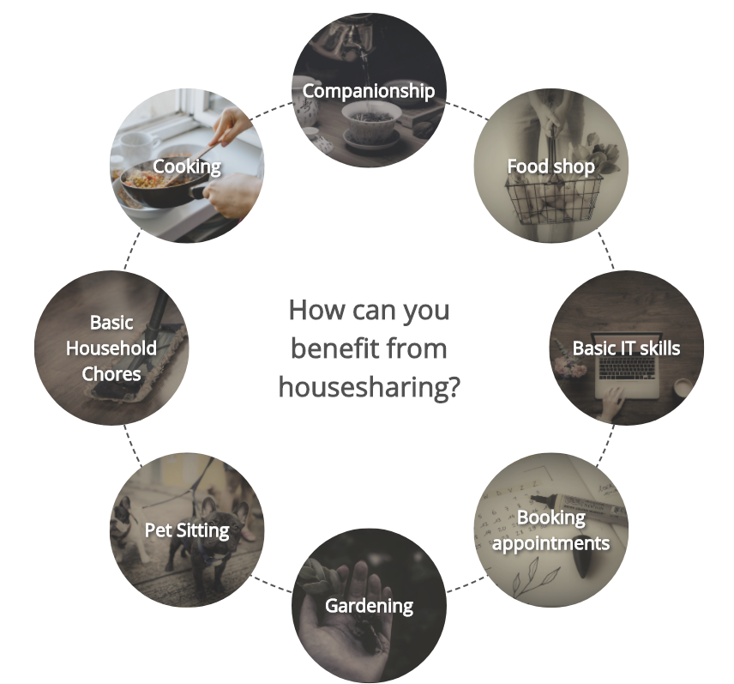
Inter-generational Relationships
Householder + Homesharer = Homeshare
Householder
Typically an older person with a spare room, who may feel lonely or isolated, looking for companionship and practical support in order to remain in their home.
Homesharer
Typically a younger person (e.g. mature student, care workers) who lives with the Householder, providing company, help around the house and offering the peace of mind and reassurance of an overnight presence.
Possible help offered through Homesharing

Slide 5
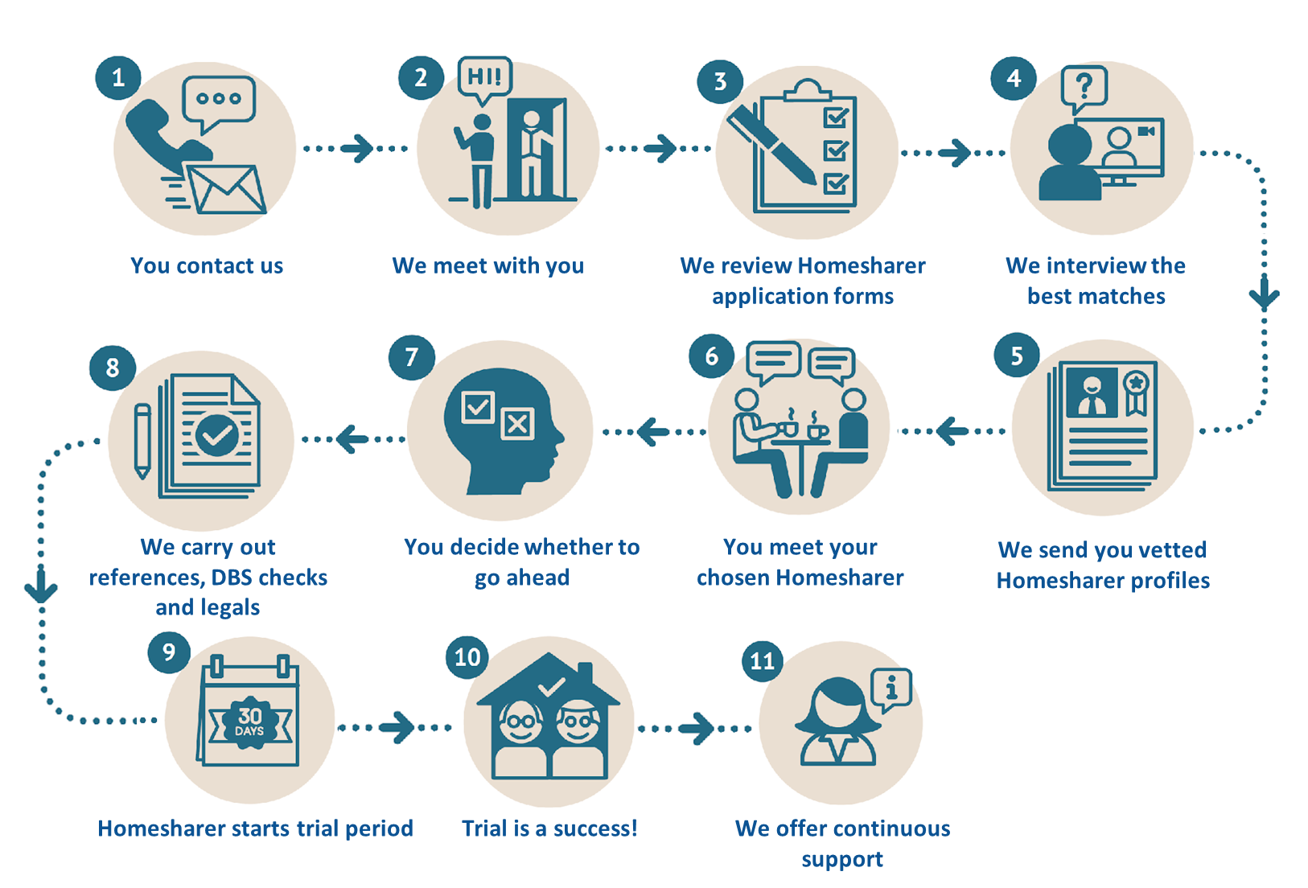
Matching Homesharers

Slide 6
Successful Safeguarding
Safeguarding of our Householders is our priority.
We have a stringent vetting process of our sharers.
Sharers complete detailed and thorough application forms
Sharers are interviewed via phone and video
All sharers will have an Enhanced DBS (Police check)
References are obtained
Householders and their families have several opportunities to meet sharers before the Homeshare begins - often including a trial weekend stay
We remain a constant point of contact and support throughout the Homeshare
for both the Householder and Homesharer.

Slide 7
















Partners

Slide 8
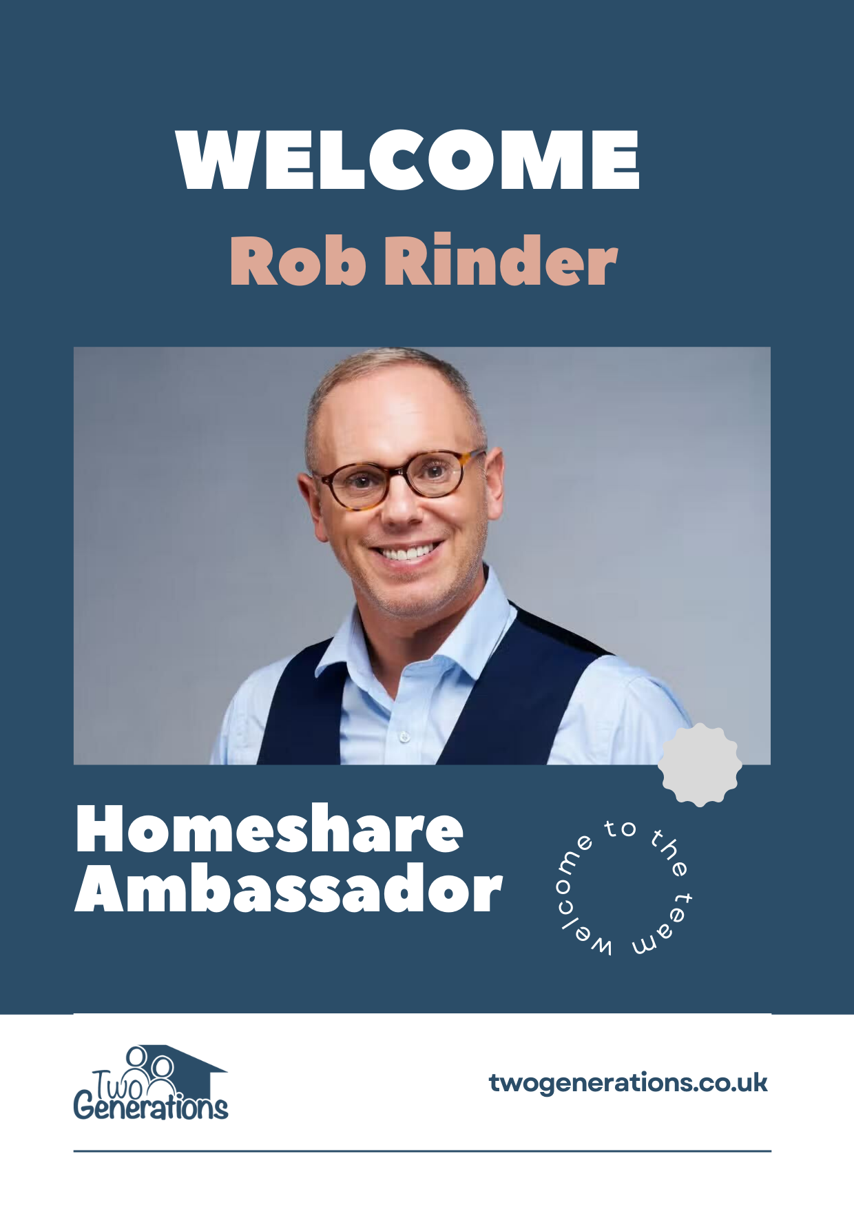
Ambassadors
New Ambassador Programme In 2024
High profile individuals
Personal experience e.g. family, friends
Share Homeshare stories with their audiences
Promote partner causes

Slide 9

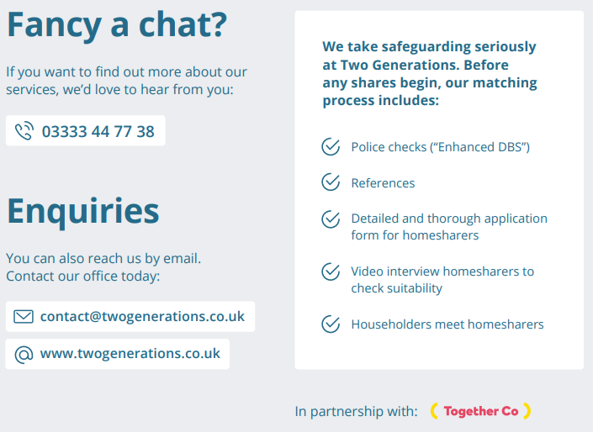

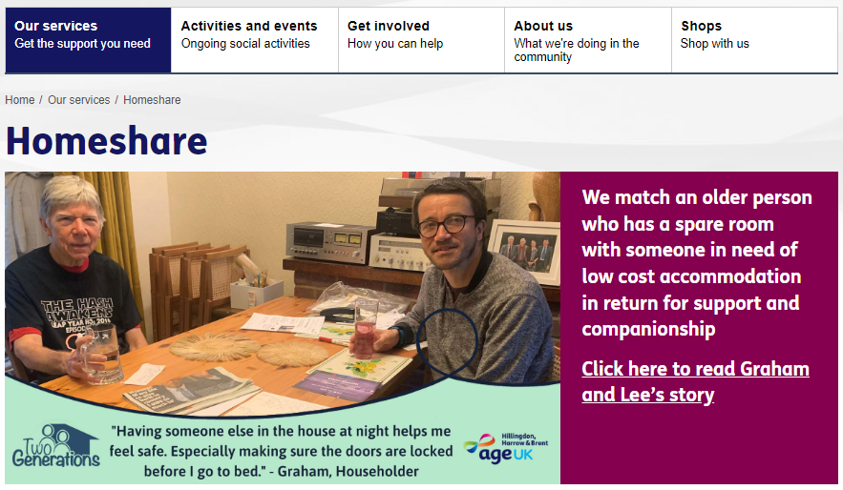
Partners
Public sector e.g. councils, ICBs, Unis
3rd sector eg. Age UK, CWC
Private sector e.g. Carents Room, Joy app
Partners signpost, Two Generations matches & manages Homeshares
Two Generations helps with
-advice & information for your teams
-weblinks, contact numbers
-news, blogs, case studies, brochures
-support for your media & events
contact@twogenerations.co.uk

